Slide 1

Fall’ 18 SWE422: Numerical Analysis With Lab
Prianka Mandal
Lecturer
Daffodil International University

Slide 2

Introduction
Numerical analysis was invented by a very old professor. Whenever he would write on the blackboard, his hands would shake. So whenever he was trying to write =, it would always come out ≈ !
Just a JOKE!

Slide 3
Why study Numerical Analysis?
Numerical analysis is the branch of mathematics that is about approximate computing [≈].
It is an approach for solving complex mathematical problems using only simple arithmetic operations.
It tells how quickly you can get close to the solution.
Numerical computations play an indispensable role in solving real life mathematical, physical and engineering problems.
Examples: Weather Forecast, Neural Network, Real-time Traffic measurement and so on.

Slide 4
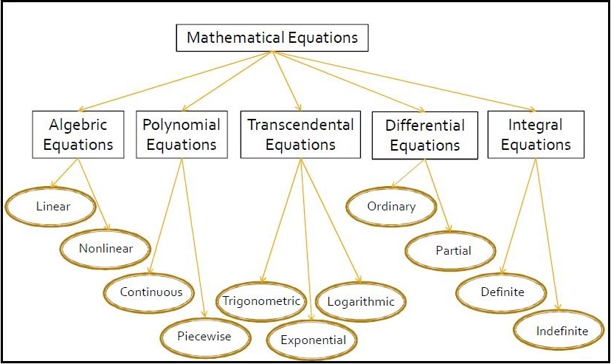
Different forms of mathematical equations:

Slide 5
Advantages of numerical analysis:
The major advantage of numerical analysis is that even the problem has no “analytical” solution, a numerical value can be obtained from it.
It gives a result in terms of mathematical functions that can be evaluated for specific instances.
The mathematical operations requires essentially addition, subtraction, multiplication and division plus making comparison!

Slide 6
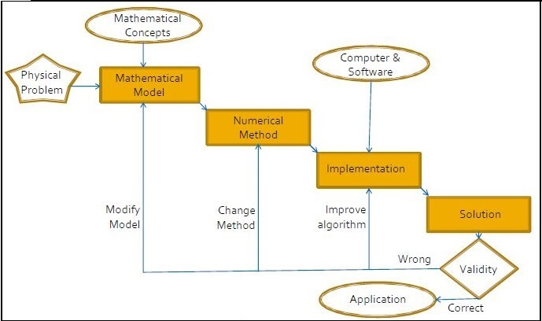
Numerical Computing Process

Slide 7
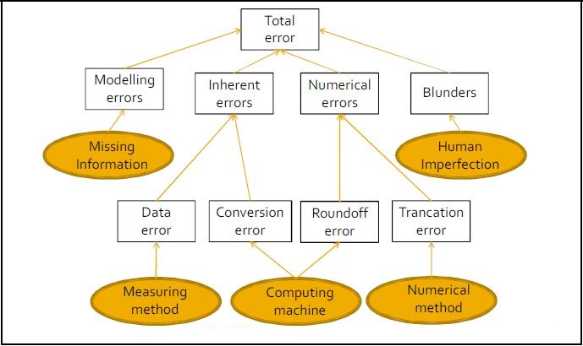
Taxonomy of errors

Slide 8
Modelling errors
In many situations it is impractical to model each of the components accurately. So, certain simplifying assumptions are made.
For example, while developing a model for calculating the force acting on a falling body, we may not be able to estimate the air resistance co-efficient properly.
Since, the model is the basic input to numerical process, no numerical method will provide adequate results if the model is wrongly visualized and formulated.

Slide 9
Inherent errors
Inherent error is also known as input error.
It contains two components:
Data errors.
Conversion errors.
Data errors:
Data error also known as empirical error, arises when data for a problem are obtained by some experimental means.
This may be due to some limitations in instrumentation and reading.

Slide 10
Inherent error (continued)
Conversion errors:
Conversion error is also known as representational error.
Is occurs due to the limitations of the computer to store the data exactly.
Example: Conversion of 0.1 in decimal to binary.

Slide 11
Numerical errors
Numerical errors are also known as procedural error.
It appears during the process of implementation of a numerical method.
There are two types of numerical errors:
Round-off error
Transaction error

Slide 12
Numerical errors (continued)
Round-off error:
It occurs when a fixed number of digits are used to represent exact numbers.
Example: 42.7893 will rounded off up to 2 decimal digits as 42.79

Slide 13

Numerical errors (continued)
Transaction error:
Transaction error arise from using an approximation in place of an exact mathematical procedure.
We often use finite number of terms to estimate the sum of infinite series.

Slide 14
Blunders
Blunders are the errors that are caused due to human imperfection
Some common types of this error are:
Lack of understanding of the problem
Wrong assumption
Mistake in data input.
Select wrong algorithm for implementing numerical method.

Slide 15
Other types of errors
True error
Relative true error
Approximate error
Relative Approximate error

Slide 16
True error
True error is the difference between the true value and the approximate value.
Also called as exact value.
True error = true value – approximate value

Slide 17

Relative true error
Relative true error is denoted by
It is the ratio between true error and true value

Slide 18
Approximate error
Approximate error is defined as the difference between the present approximation and previous approximation.
Approximate error = Present approximation – Previous approximation

Slide 19
Relative Approximate error
Relative approximate error is defined as the ratio between the approximate error and the present approximation.

Slide 20
Thank you!!!

